Slide 1
Evaluating Magist as a Partner for Eniac’s Expansion into the Brazilian market
GROUP I: Kelechi, Maryna, Lidia, Anna
Data Analysts
Notes:
Today we’re going to see why Magist is NOT the perfect partner for our Brazilian expansion, but why and how we should still sign with them.

Slide 2
Table of contents
01
03
02
04
Expansion into Brazil
Suitability Analysis
Introduction to Magist
Conclusion & Recommendation
Notes:
Pls only briefly show; I won’t talk about this, so jump to next slide.

Slide 3

01
Expansion into Brazil

Slide 4
Brazil presents a promising expansion opportunity for Eniac
1) Source: https://www.statista.com/topics/4697/e-commerce-in-brazil/
Why Brazil?
Brazil is one of the largest and fastest-growing eCommerce markets in Latin America¹
Significant growth potential for Eniac
Challenges
Lack of local market knowledge
Need for ties with local providers and services

Slide 5
02
Introduction to Magist

Slide 6
Magist Provides Comprehensive Services for Order Management
Who is Magist?
Advantages
Brazilian SaaS company
Centralized order management
Stock and warehouse management, product shipment, and customer service
Economies of scale
Reduced costs and bureaucracy

Slide 7
03
Suitability Analysis

Slide 8
Magist’s product range includes a diverse array of products
Magist’s diverse product coverage includes various categories
75 categories
Tech products account for
11 categories¹
1) Tech product categories: audio, computers, computers_accessories, consoles games, dvds blu ray, electronics, fixed telephony, pc gamer, tablets printing image, telephony, watches gifts

Slide 9
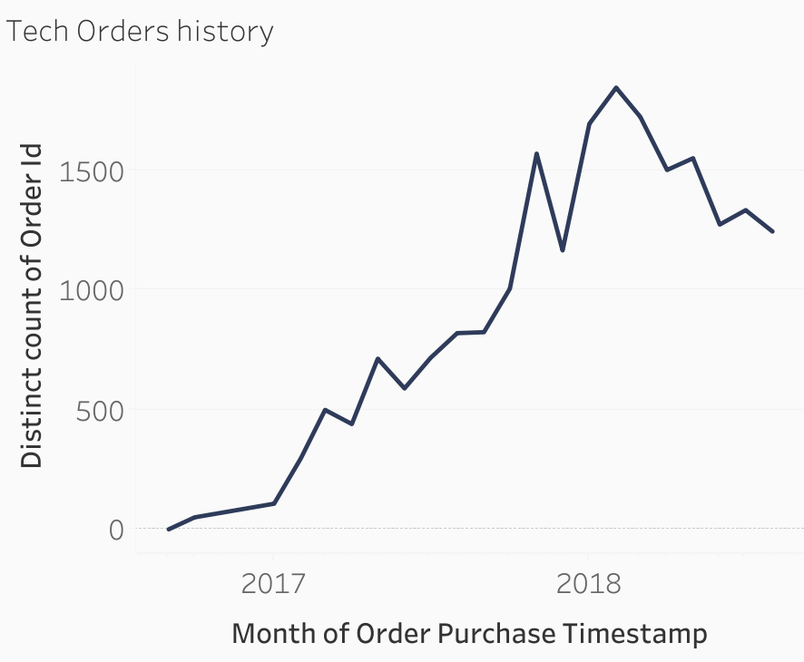
Magist’s Tech Orders Initially Rose Before Declining Since February 2018
Tech products account for 21% of all orders
Tech orders increased significantly up until Feb 2018, showing strong growth potential
Notable decrease of ≈-33% in tech orders since February 2018

Slide 10
Magist’s prices for tech products are below our average
133€
is the average price for Tech products
5%
of all Tech products sold are priced 500€ or more

Slide 11
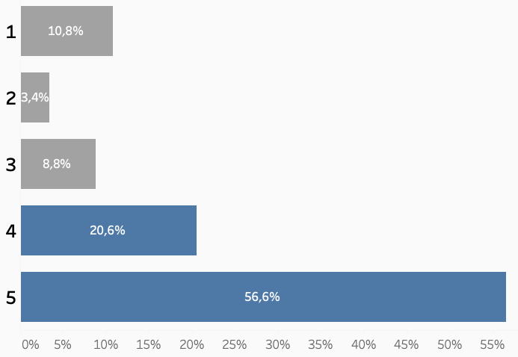
Tech Product Orders at Magist Show Good Level of Customer Satisfaction
77% of all delivered orders in the tech category receive a score of 4 or 5¹
1) Satisfaction scores are rated on a scale of 1 to 5, with 1 being poor and 5 being excellent

Slide 12
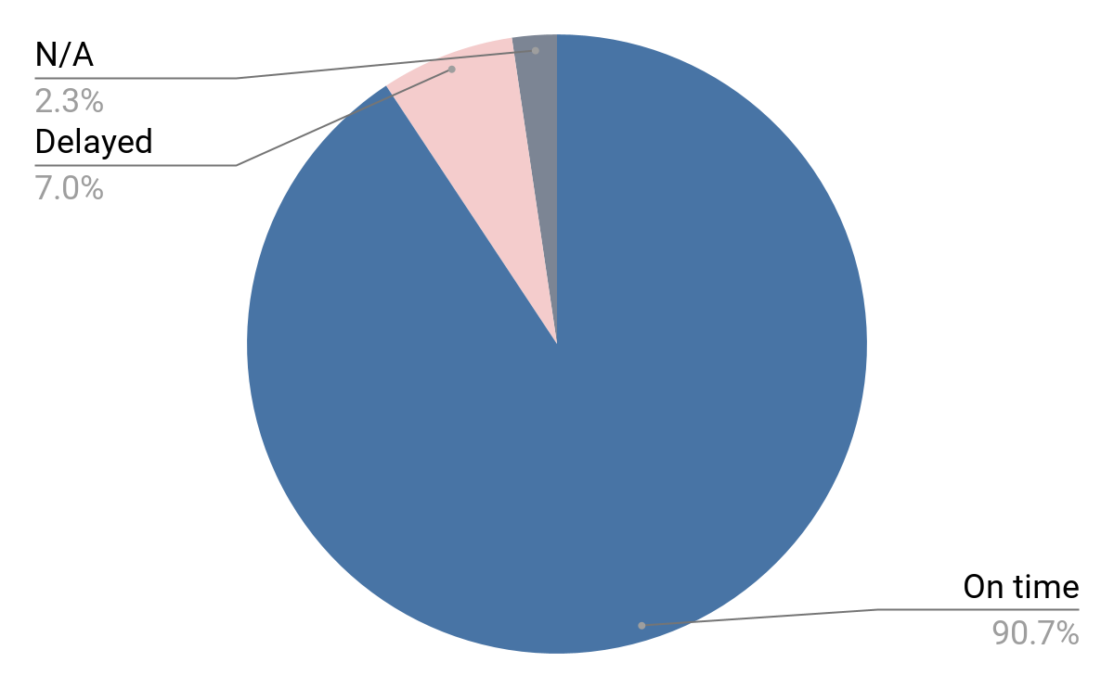
Magist Delivers ≈91% of Tech Orders On Time
90.71% of tech orders are delivered on time¹
1) On time = delivery date customer is equal or smaller than estimated delivery date; Delayed = delivery date customer is bigger than estimated delivery date; N/A = not applicable to data

Slide 13
04
Conclusion & Recommendation

Slide 14
Magist is not our ideal partner, but still a good start
Tech products limited
Good Customer satisfaction
Good delivery performance
Magist’s focus on tech products is limited when compared to the overall categories.
77% of tech product orders received a score of 4 or 5
Magist’s delivery performance is generally good, with average delivery of 13 days.
WATCH OUT:
Ask Magist to explain why the tech sellers number is increasing, but the tech products orders have been declining for the past 6 months.

Slide 15
Proceed with Caution and Use Magist as an Interim Solution
1 year contract + CPA payout
Build brand awareness
Explore alternative partnerships
Instead of 3 years. Also have a mixed model payout: fix cost + Cost Per Action (e.g. when order is delivered on time, or cost per sale, or other actions).
During the test, focus marketing efforts on brand awareness in Brazil, optimizing campaigns based on the acquired direct market knowledge.
During the test, search and contact other SaaS partners in Brazil that are a better fit (e.g. shorter delivery time, more tech experience, etc.).

Slide 16
Thanks!
Do you have any questions?

Slide 17
Appendix

Slide 18
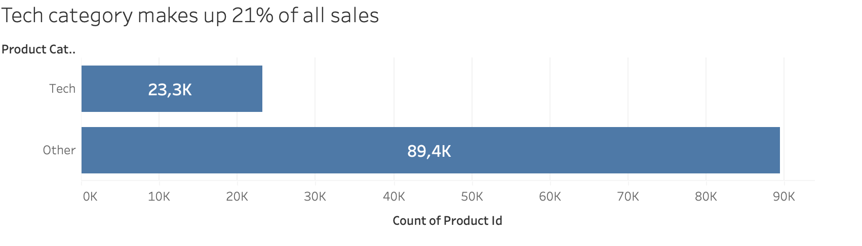
Plot1

Slide 19
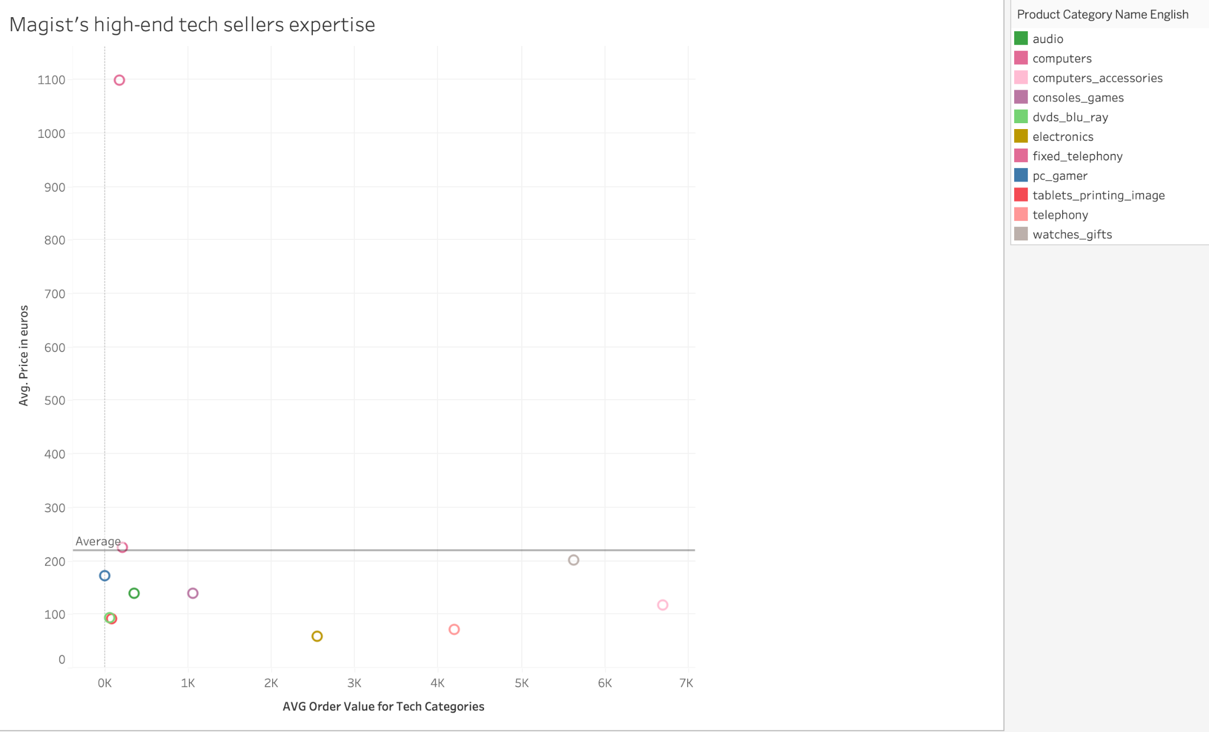
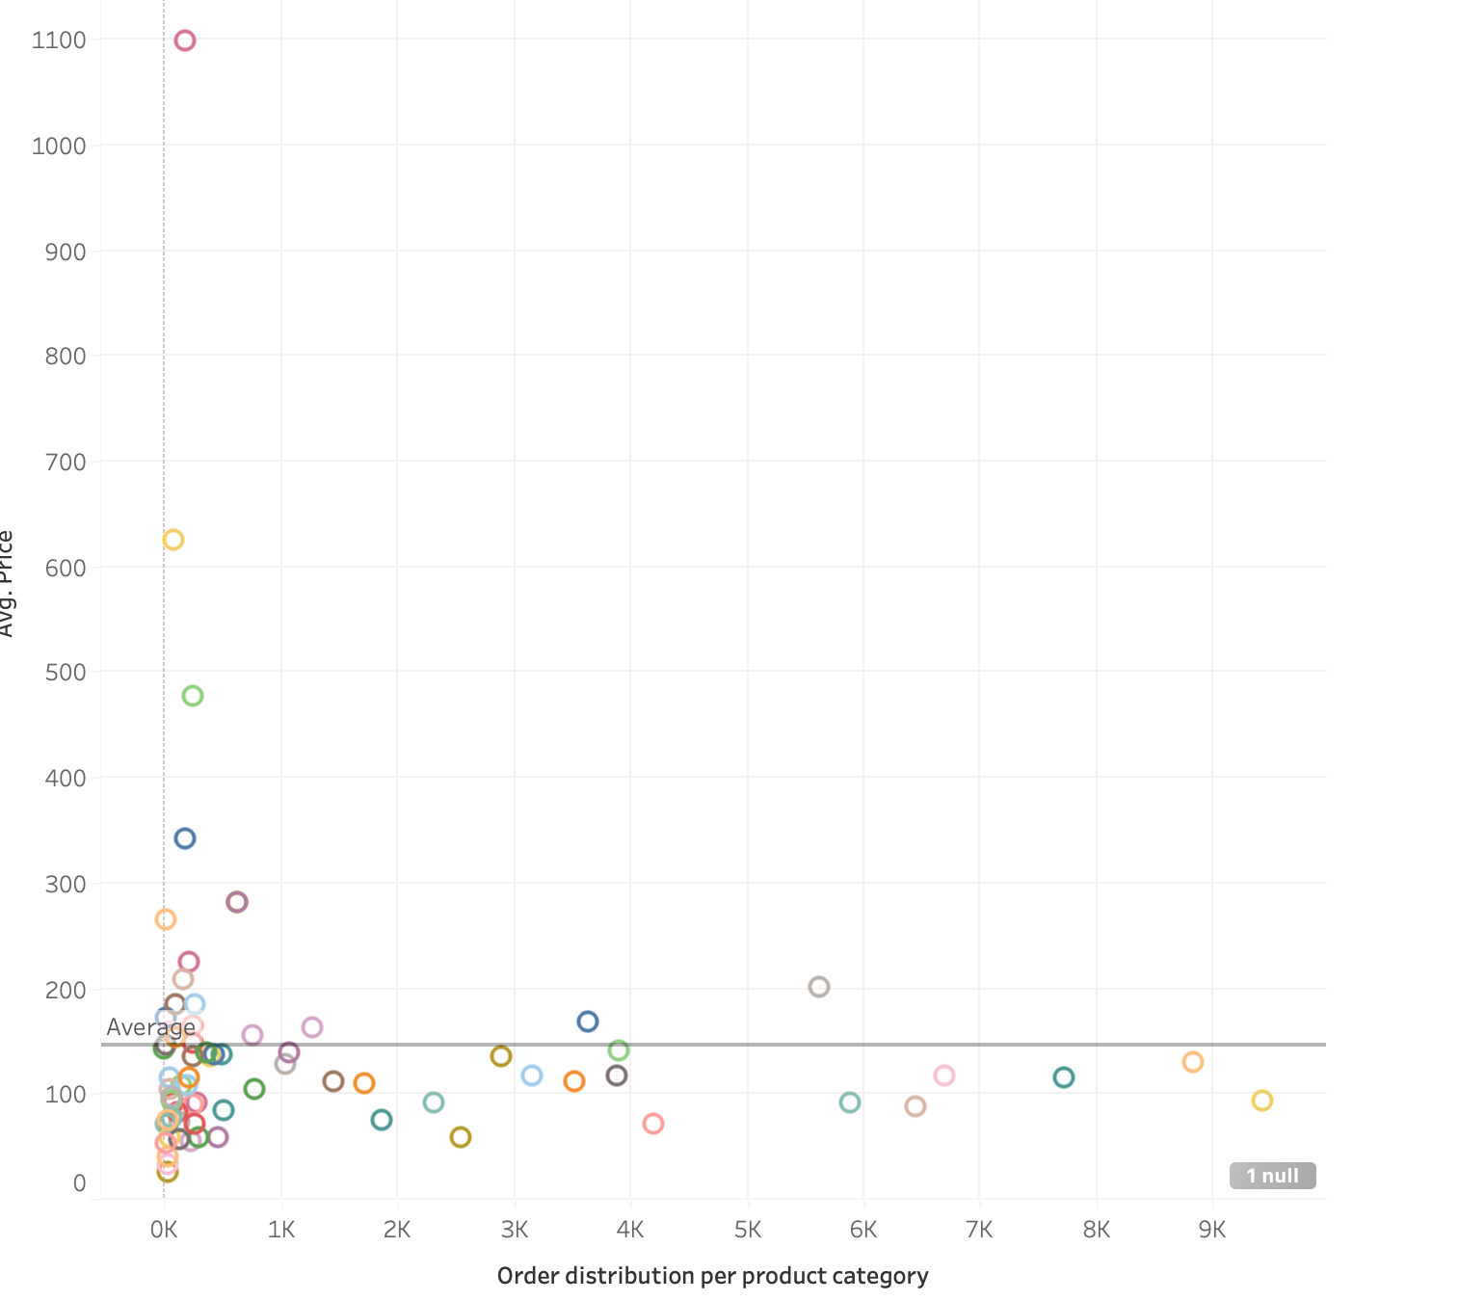
Plot 2
Though most orders are below the average value, Magist still has high-end products expertise, also in the tech sector.

Slide 20
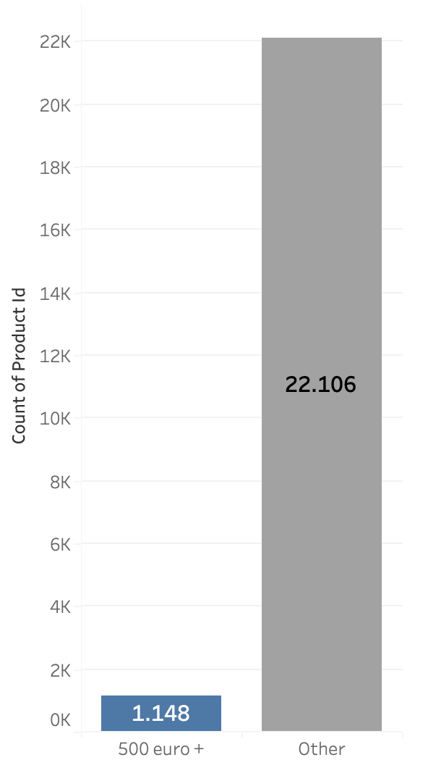
Plot3
Expensive tech products make up 5% of all sales in the tech category

Slide 21
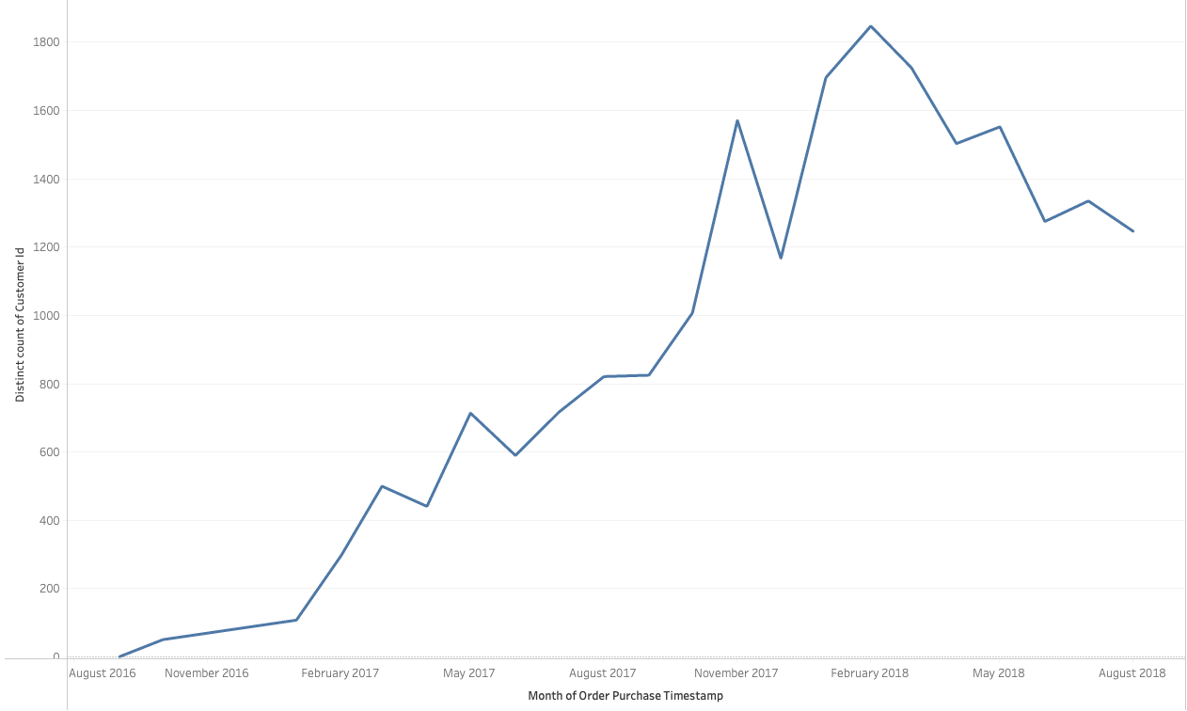
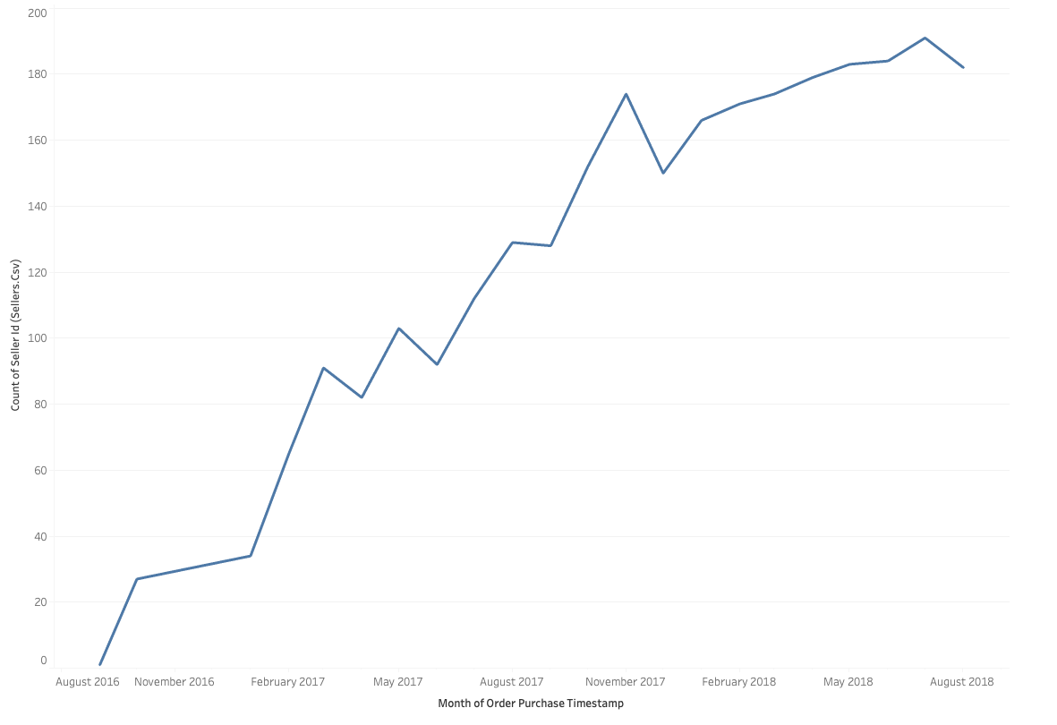
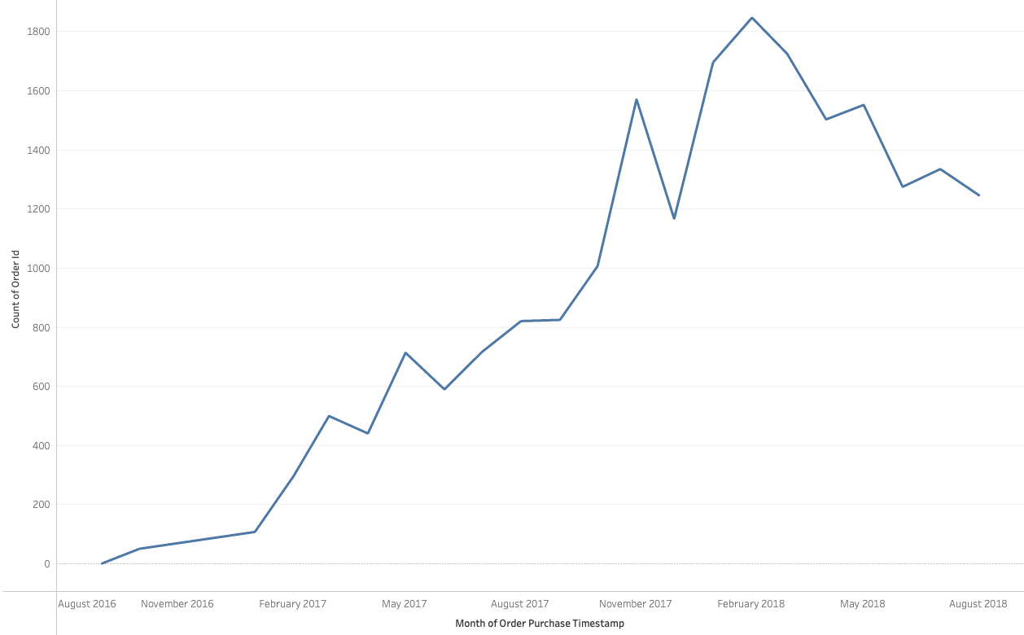
Plot4
Tech sellers number is increasing, while number of orders and customers in tech categories going down.

Slide 22
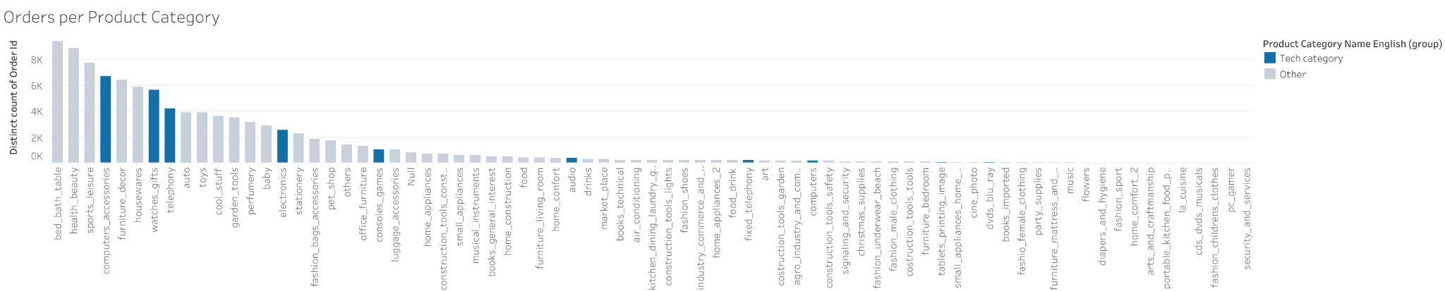
Plot5
Order per Product category plot shows that 3 Tech Categories are under the top 10 Product categories.

Slide 23
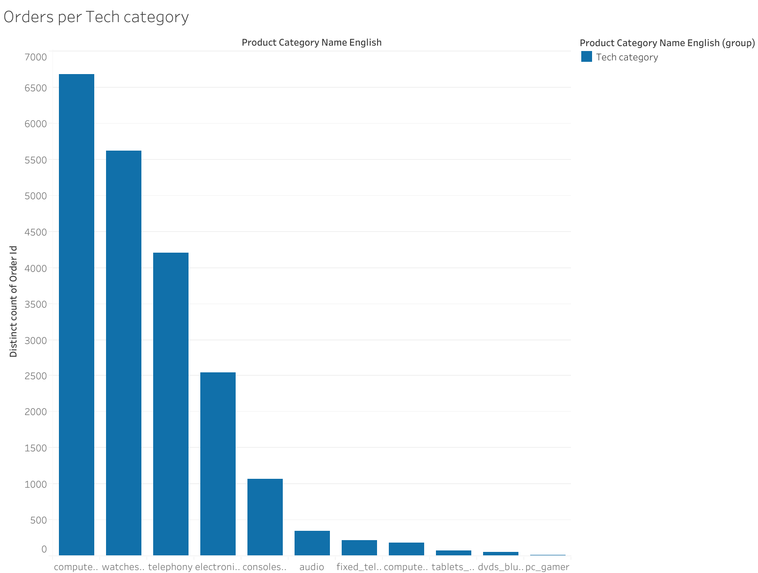
Plot6
Order per Tech category plot shows that computer accessories, watches and telephony are the top 3 Tech categories.

Slide 24
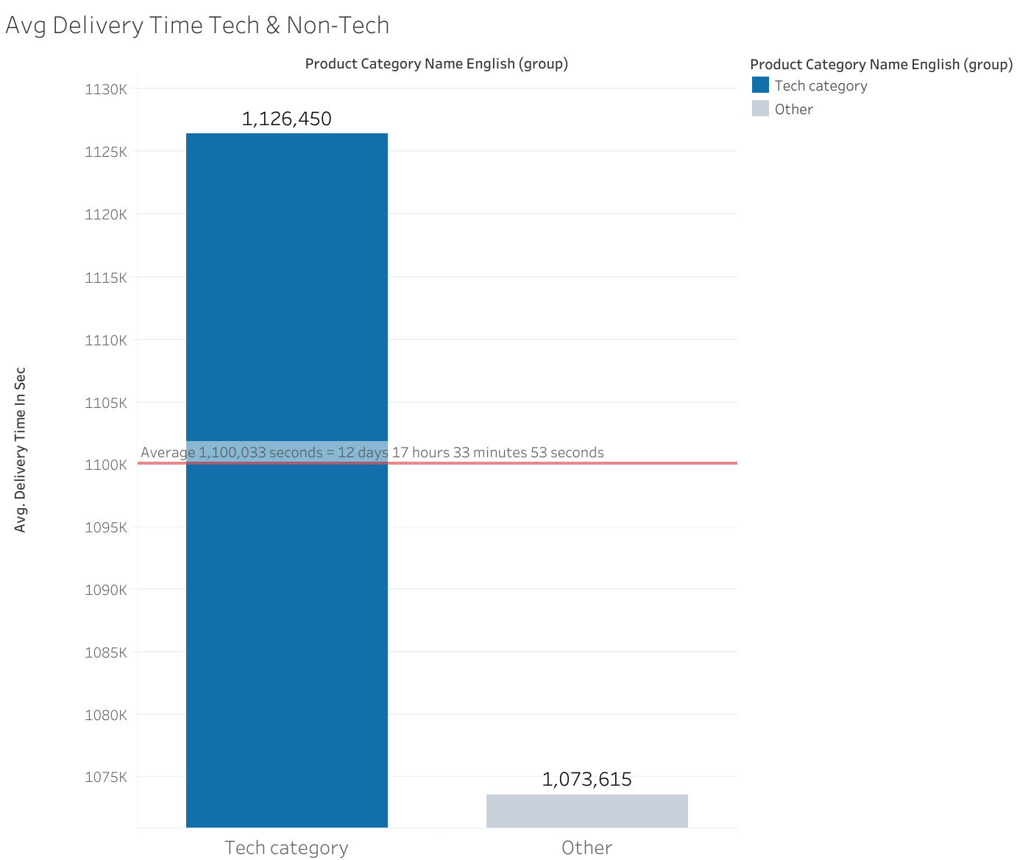
Plot7
Average delivery time overall:
12 days 17 hours 33 minutes 53 seconds
Average delivery time for Tech:
13 days 0 hours 54 minutes 10 seconds
Average delivery time for
Non Tech:
12 days 10 hours 13 minutes 35 seconds

Slide 25
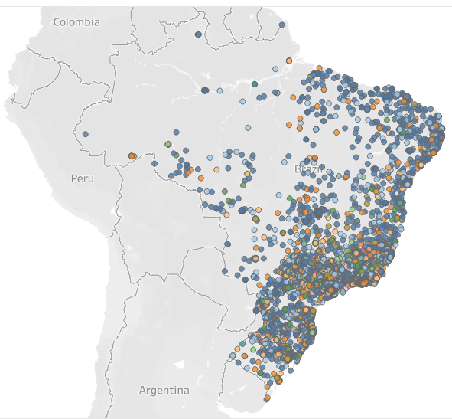
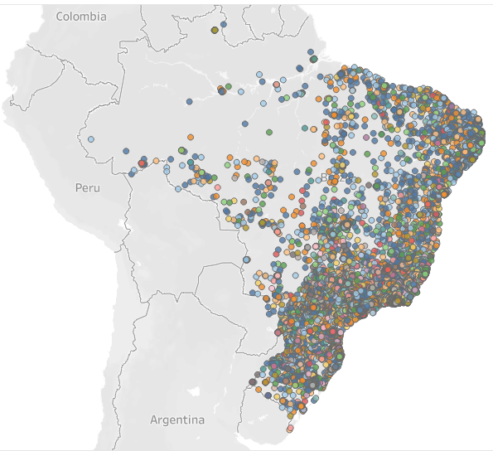
Plot8
Tech Customers locations
Other Customers locations

